Slide 1
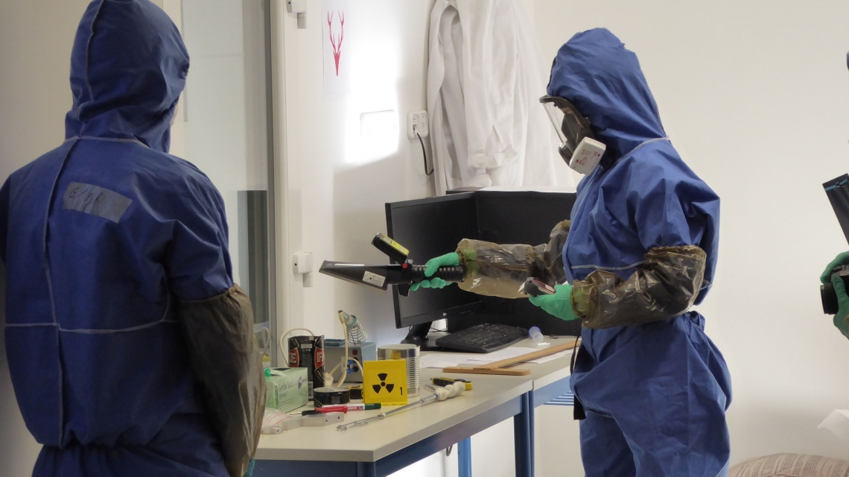
Introduction to
Nuclear forensics
28th October 2020
https://www.iaea.org/newscenter/news/crime-scene-to-court-room-implementing-nuclear-forensic-science

Slide 2
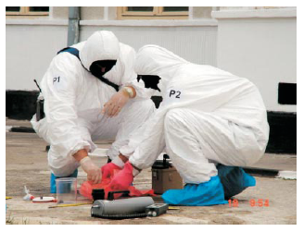
Nuclear forensics
Nuclear forensics involves the laboratory analysis of seized illicit nuclear materials or debris from a nuclear detonation to identify the origins of the material or weapons.

Slide 3
What is Nuclear Forensics?
Nuclear Forensics is defined as a methodology that aims at re-establishing the history of nuclear material of unknown origin.
Extract the historical information from the nuclear evidence
  What? Where? When?
  Radioactive material
    Isotopic composition
    Place of origin
    Trafficking route
    Age
Notes:
Methodology = ระเบียบวิธีการ

Slide 4
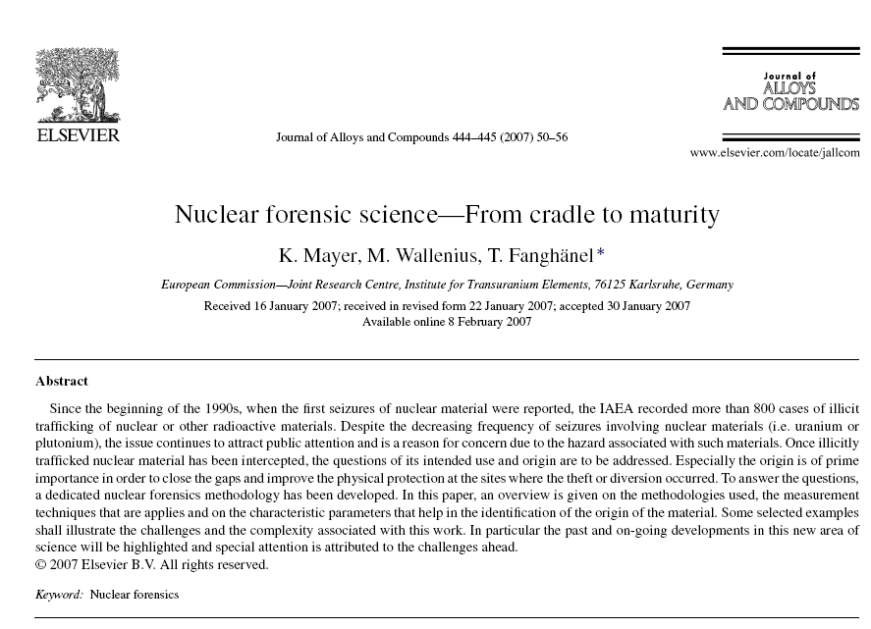
Notes:
International Atomic Energy Agency IAEA = ทบวงการพลังงานปรมาณูระหว่างประเทศ เป็นทบวงการชำนัญพิเศษของสหประชาชาติเพื่อทำหน้าที่เป็นองค์กรกลางในการตรวจพิสูจน์นิวเคลียร์ (nuclear verification) ความปลอดภัยทางนิวเคลียร์ (nuclear safety) และส่งเสริมการใช้พลังงานนิวเคลียร์ในทางสันติ

Slide 5
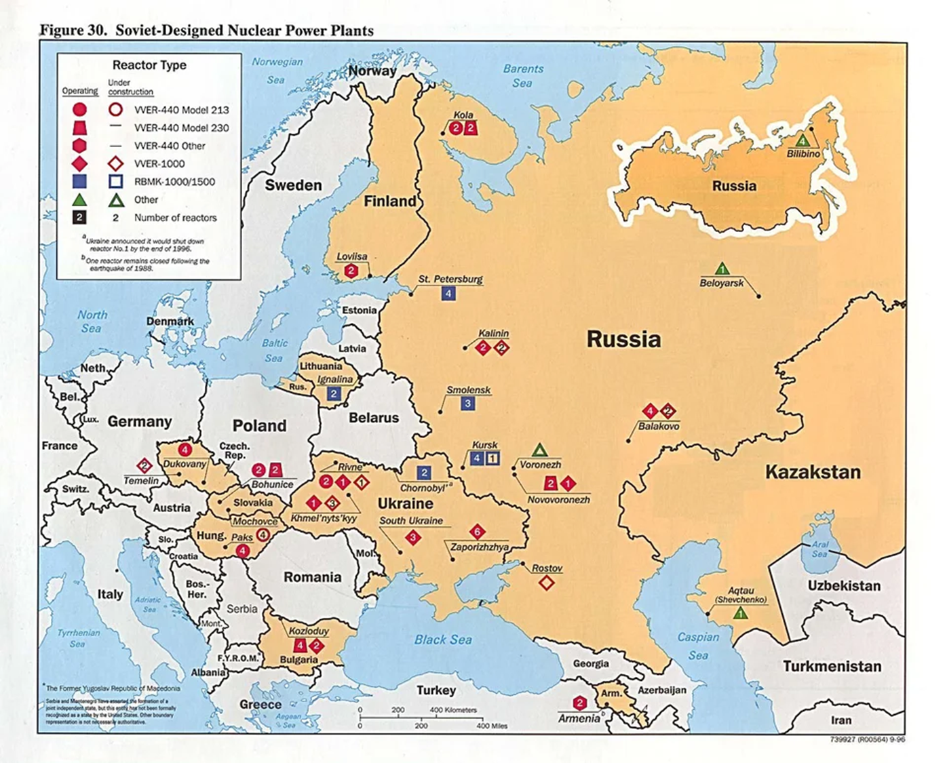
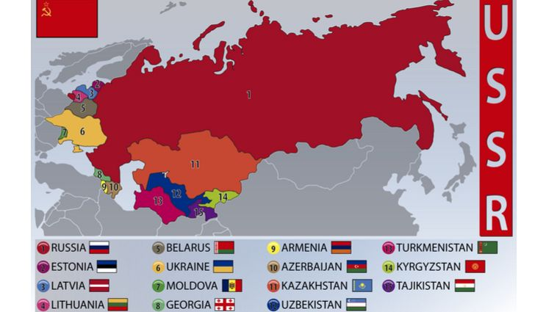
Dissolution of USSR in 1990’s
( Union of Soviet Socialist Republics, or USSR)
https://chnm.gmu.edu/1989/items/show/175
https://www.worldatlas.com/articles/what-countries-made-up-the-former-soviet-union-ussr.html
Notes:
The Soviet Union (full name: Union of Soviet Socialist Republics, or USSR)

Slide 6
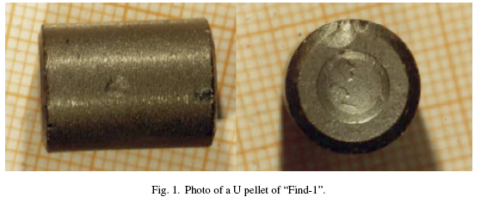
What is this?
In March 1992, uranium fuel pellets were seized in Germany.
The nuclear materials were analyzed and investigated their measurable properties such as isotopic compositions, physical dimensions and chemical impurities. The analysis aims to identify the origin and intended use.
The seizure consists of 72 uranium pellets so called “Find 1.”
Nuclear material refers to the metals uranium, plutonium, and thorium, in any form.
Notes:
In March 1992 seized nuclear material was analysed at the
ITU Institute for Transuranium Elements (ITU) in Karlsruhe
for the first time. It marked the birth of a new discipline
in science: nuclear forensics. This first seizure, the so-called
“Find-1” was intercepted in Augsburg, Germany and it consists
of 72 uranium pellets

Slide 7
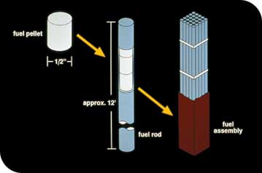
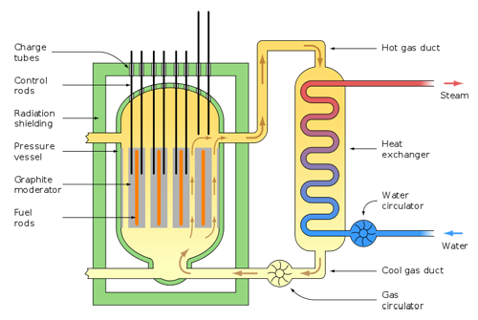
Fuel pellets are inserted into fuel rods, which are grouped together in a fuel assembly.
Fuel rods are placed into the reactor to start nuclear reaction.
https://panthersgetnuclear5.wikispaces.com/Types+of+Nuclear+Reactors
Notes:
When an incoming neutron causes the nucleus of an atom to split, other neutrons are released at very high speed. If at least one (on average) of these neutrons can be made to cause split another fuel atom, a sustained chain reaction is possible. As it happens, fuel atoms (like uranium) are more likely to absorb a neutron whizzing by if it’s going slow (see Figure 1). So, many reactor designs use moderators to make a chain reaction easier to attain.
Graphite modulator ทำหน้าที่ slow down นิวตรอน เพิ่มโอกาสในการเกิดปฏิกิริยา fission.
Control rod ทำหน้าที่จับ neutron ทำให้สามารถควบคุมอัตราการเกิดปฏิกิริยานิวเคลียร์ ฟิชชัน ไม่ให้เกิดมากจนเกินไป

Slide 8
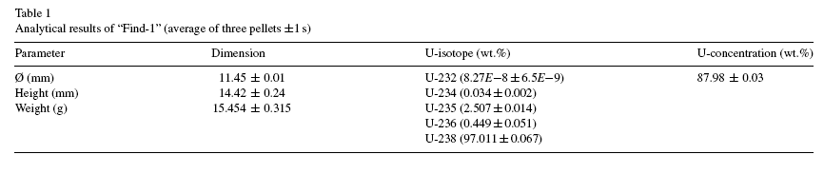
Analysis of “Find 1”
Preliminary results in terms of the physical dimensions and isotropic composition pointed out that the materials were intended to be used as fuel pellets for a nuclear reactor.
The materials were low-enriched uranium fuel pellets (∼ 5% of U-235 concentration).
Notes:
Low enriched uranium (LEU) has a lower than 20% concentration of ²³⁵U
The investigation aims to identify the origin and intended use.

Slide 9
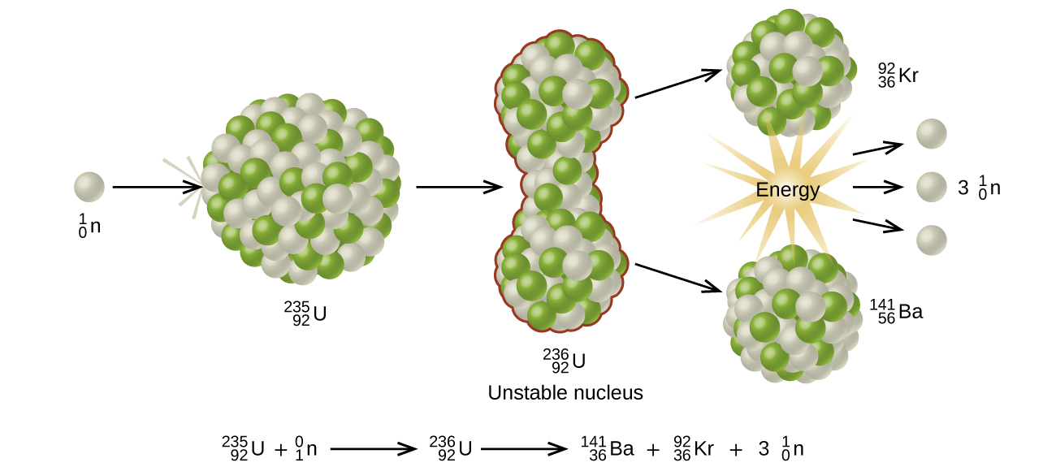
Isotopes from the nuclear fission
In a nuclear reactor, when a slow neutron hits a fissionable U-235 nucleus, it is absorbed and forms an unstable U-236 nucleus.
The U-236 nucleus then rapidly breaks apart into two smaller nuclei (in this case, Ba-141 and Kr-92) along with several neutrons (usually two or three), and releases a very large amount of energy.
The presence of U-236 in the fuel shows that the uranium has been exposed to neutrons, thus having been previously in a reactor.
This information can be used to confirmed its intended use.

Slide 10
Dimensions
The shape of the pellet depends on the type of reactor the fuel is produced for.
The dimensions indicates that the pellets were highly likely used for RBMK reactor can used to traced
back to the nuclear reactor.
https://doi.org/10.1515/ract-2018-3068

Slide 11
Dimensions of the pellet
Because the dimensions are characteristics for different reactor types, varying significantly from reactor type to another.
The intended use of the pellet was for a Russian type graphite moderated reactor (RBMK).
https://doi.org/10.1515/ract-2018-3068

Slide 12
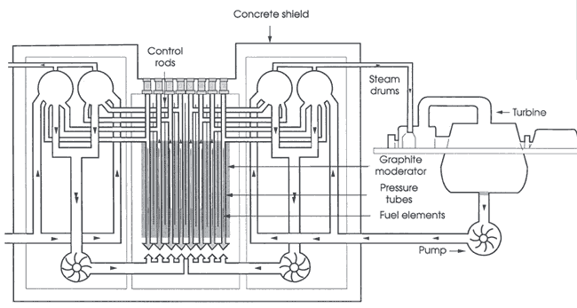
Nuclear power plant RBMK type in Russia
RBMK (reaktor bolshoy moshchnosti kanalniy means reactor (of) large power (of the) channel type)

Slide 13
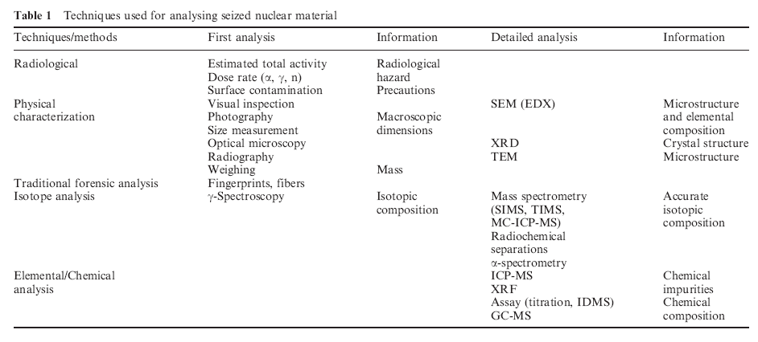
Techniques used for analyzing seized nuclear material

Slide 14
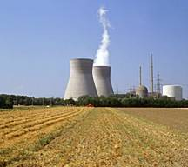
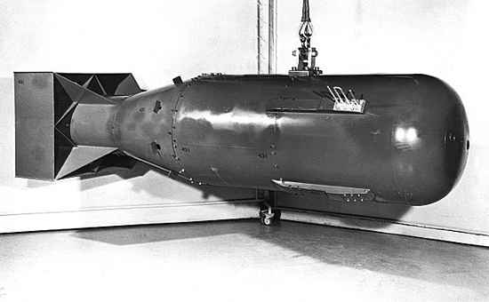
Enriched Uranium Classes
Low Enriched Uranium (LEU) 0.72-20% U 235
  LEU is primary fuel for nuclear reactors
High Enriched Uranium (HEU) >20% U 235 .
  HEU is used primarily in weapons.
  Atomic weapons of WWII used HEU of about 93.5% U 235
www.hep.fsu.edu/~wahl/phy3091/f03/talk4/BLynchTalk4.p

Slide 15
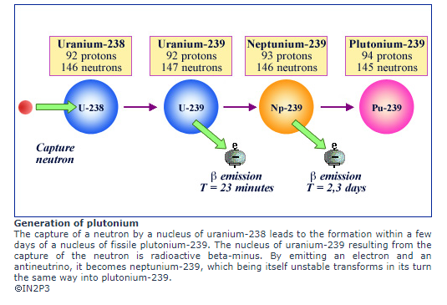
Production of Pu-239 from U-238
http://www.radioactivity.eu.com/site/pages/Plutonium_239_Formation.htm

Slide 16
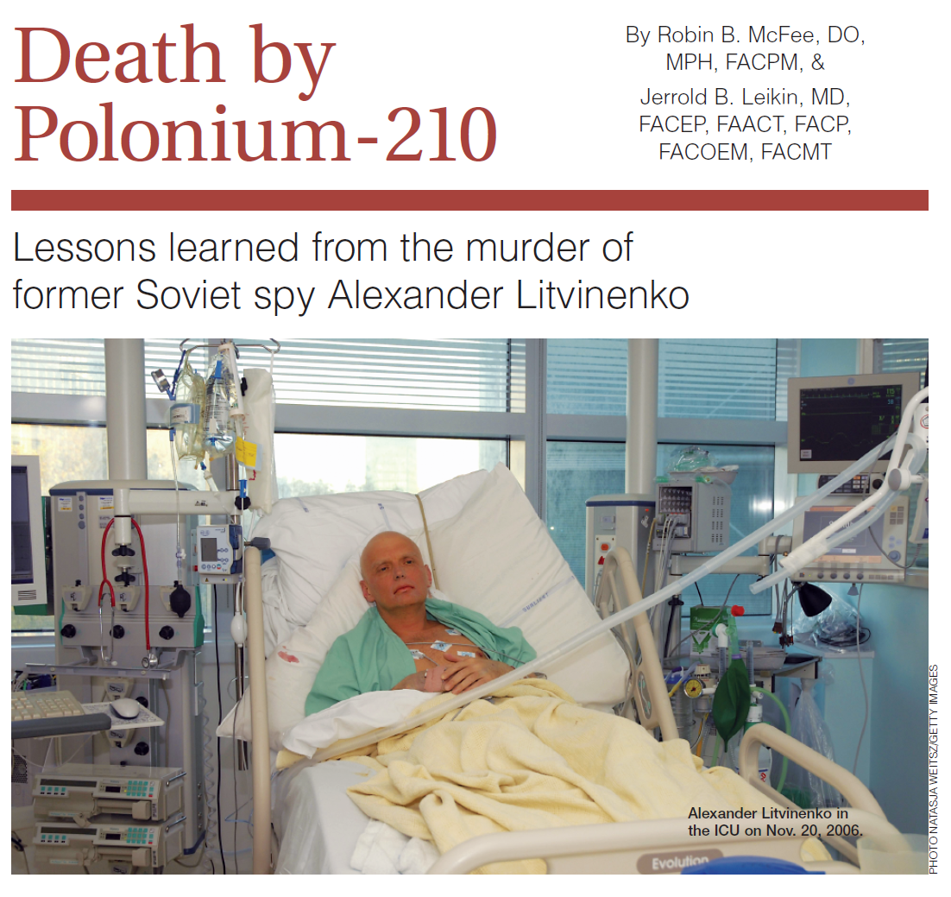

Slide 17
Case report
On Nov. 1, 2006, a former KGB agent named Alexander Litvinenko presented to a North London hospital with acute, severe, progressive gastrointestinal symptoms.
Litvinenko’s health rapidly deteriorated : his hair fell out and a reduction in the number of red and white blood cells, as well as platelets. The latter symptoms indicates the condition of pancytopenia.
The symptoms were consistent with radiation or thallium toxicity.
However, the patient’s urine and blood samples were negatively tested.
Notes:
Pancytopenia = ภาวะที่การสร้างเลือดจากไขกระดูดลดลงเนื่องจากไขสันหลังถูกทำลาย หรือเกิดการกดการทำงานของไขสันหลังทำให้ เม็ดเลือดแดง เม็ดเลือดขาวและเกล็ดเลือดต่ำลง
Thallium and its compounds are often highly toxic.^{[1]} Contact with skin is dangerous, and adequate ventilation should be provided when melting this metal.^{[2]} Many thallium(I) compounds are highly soluble in water and are readily absorbed through the skin.^{[citation needed]} Exposure to them should not exceed 0.1 mg per m² of skin in an 8-hour time-weighted average (40-hour work week). Thallium is a suspected human carcinogen (สารก่อมะเร็ง)
Thallium's toxicity has led to its use (now discontinued in many countries) as arat and ant poison.^{[1]}
Among the earliest symptoms are hair loss, which is also a standard symptom of poisoning by thallium, an element in rat poison.
Thallium เป็นสารที่จัดว่ามีความเป็นพิษสูงที่สุดตัวหนึ่ง thallium เป็นสารที่ไม่มีรสหรือกลิ่น เกลือของ thallium มีการนำมาใช้ในลักษณะของยาฆ่าหนู
https://med.mahidol.ac.th/poisoncenter/th/pois-cov/Rodent

Slide 18
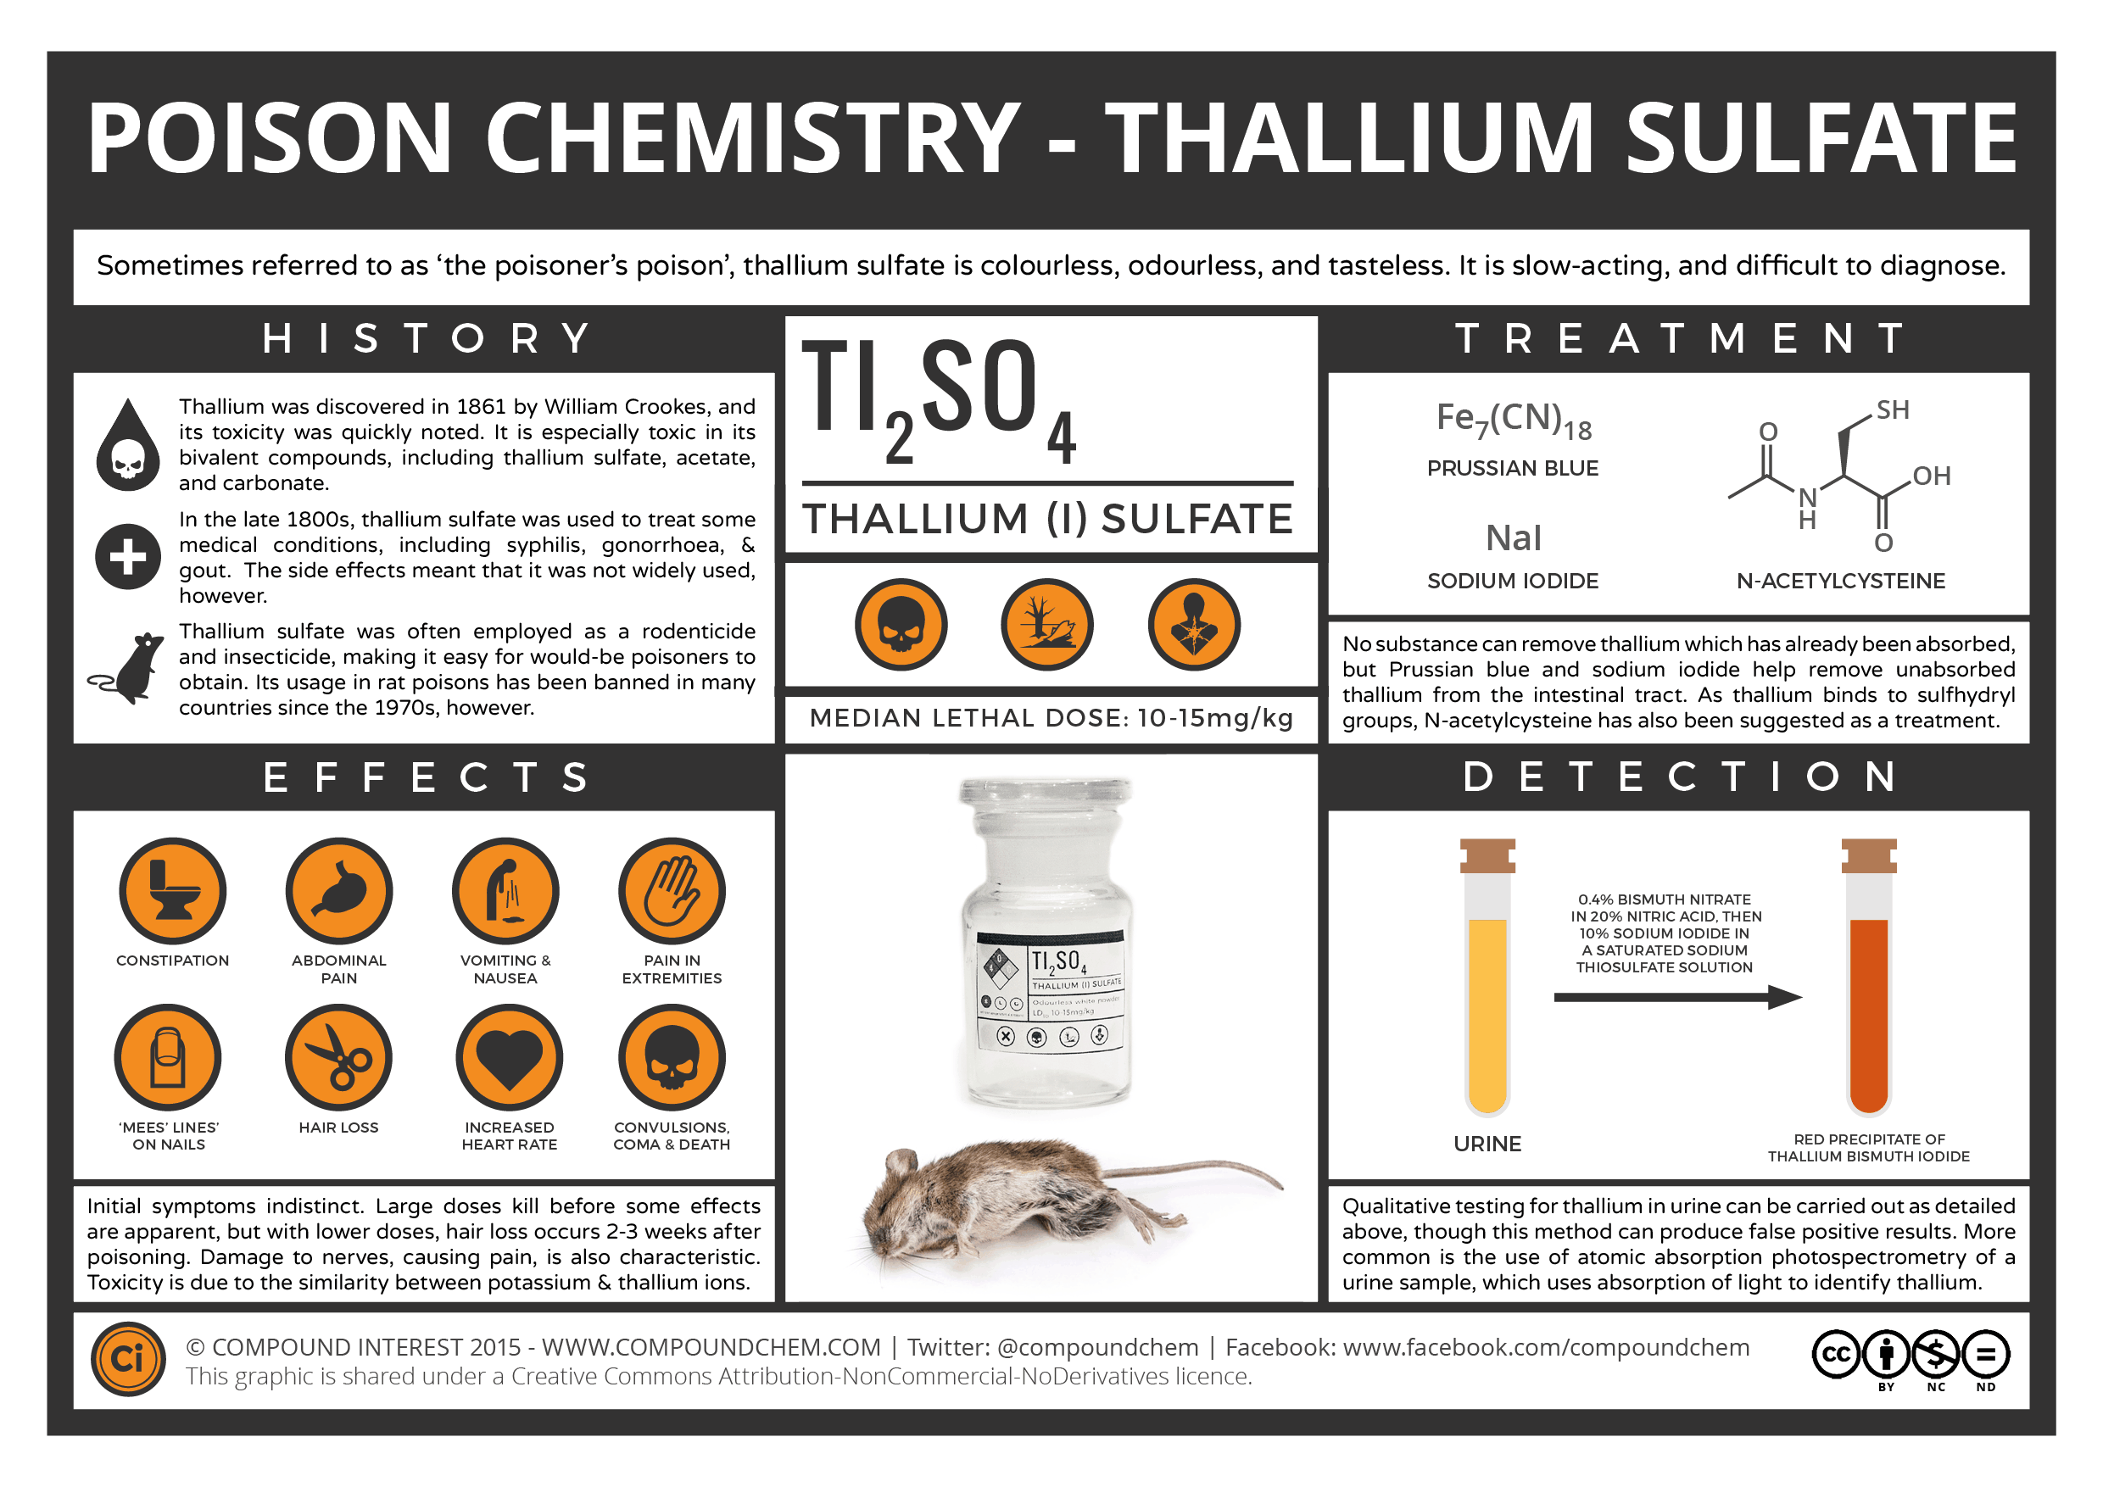
Notes:
โลหะหนัก Thallium

Slide 19
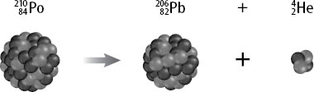
Positive test for Po-210
Advanced tests by Britain’s Atomic Weapons Establishment revealed significant amount of alpha particle radiation.
This indicated the poisoning to the patient by Polonium-210 (²¹⁰Po).
Litvinenko died of internal contamination from the radioactive.
Traces of polonium were found in several locations where Litvinenko had visited shortly before becoming ill.
https://socratic.org/questions/what-is-the-nuclear-equation-for-the-alpha-decay-of-po210

Slide 20
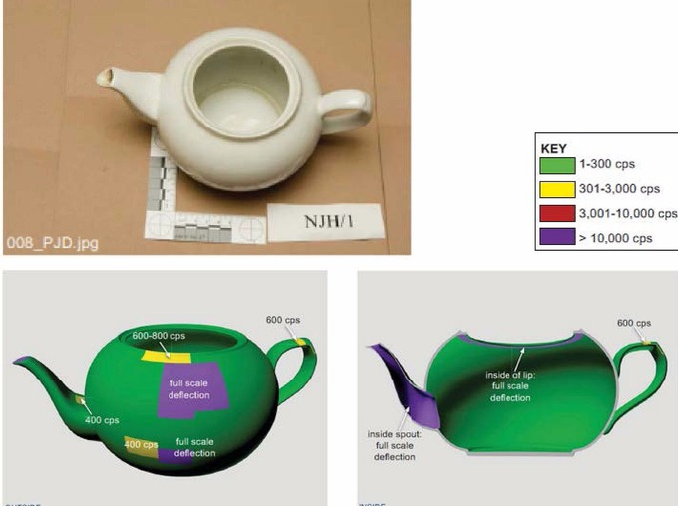
http://www.itv.com/news/update/2016-01-21/images-released-of-teapot-used-to-poison-litvinenko/
An image of the teapot used to poison Russian dissident Alexander Litvinenko have been released.
Traces of polonium 210 were discovered in the teapot in the Pine Bar at the Millennium Hotel.
Note : cps = counts per second, the indicator used to measure radiation levels.

Slide 21
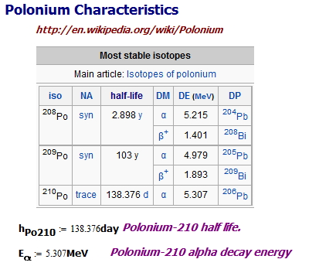
Understanding Polonium-210
Polonium is a rare radioactive metalloid, and was discovered in uranium ores by Marie and Pierre Curie in 1897.
Polonium may now be made in milligram amounts in nuclear reactors.
Polonium is a solid but dissolves readily in dilute acids.
http://mathscinotes.com/2014/01/radiation-exposure-from-cigarette-smoking/
Notes:
Short half life means high activity.

Slide 22
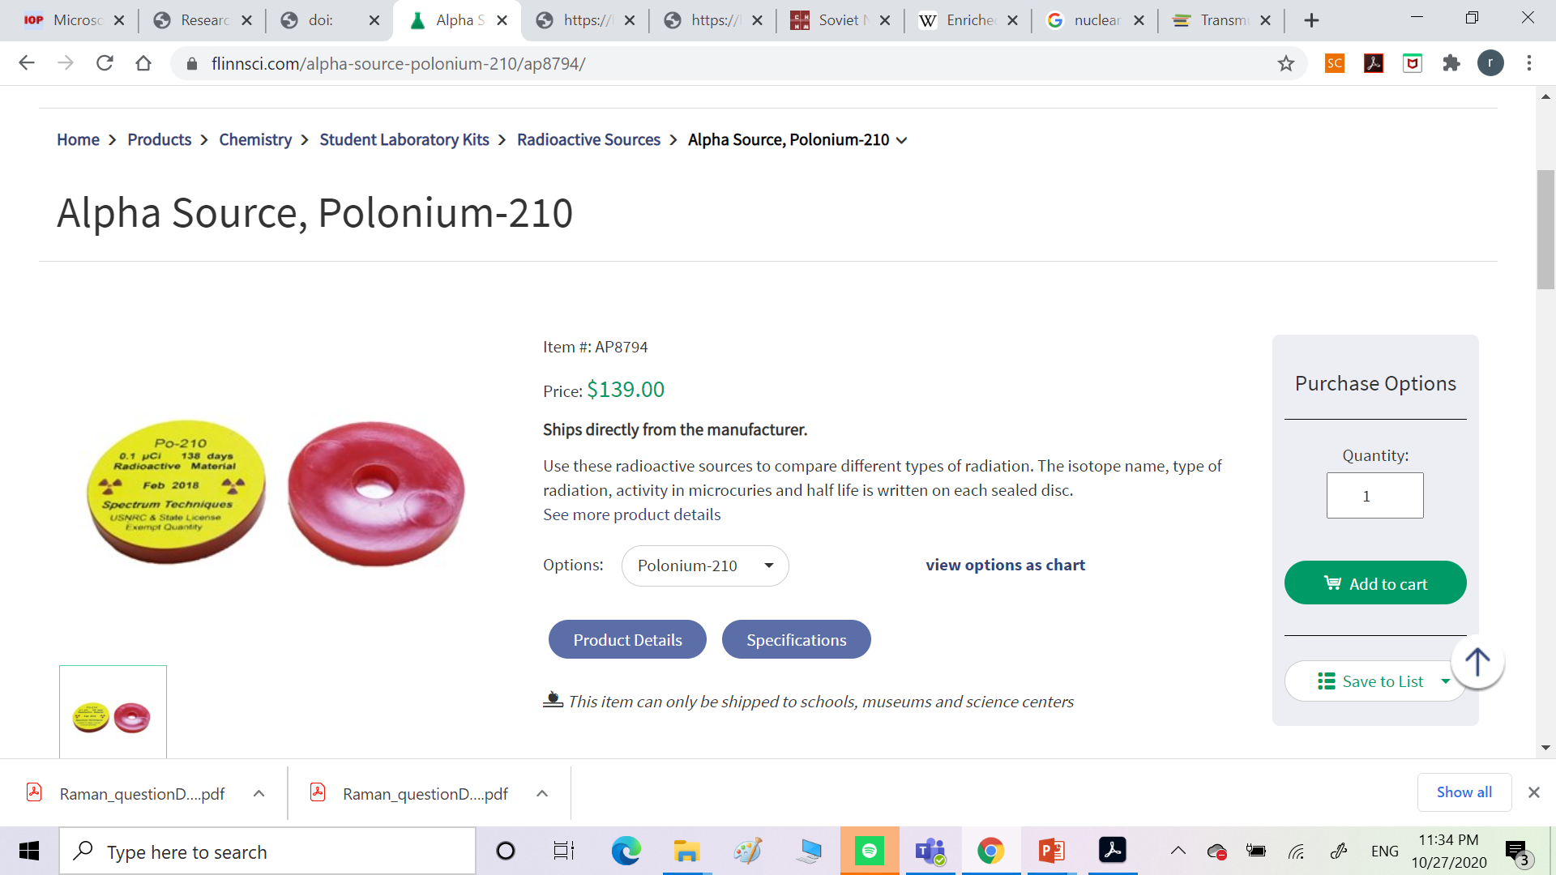
Polonium 210 on sale from internet

Slide 23
Quantifying Radioactive Decay
Measurement of Activity (กัมมันตภาพ) in disintegrations per second (dps);
1 Becquerel (Bq) = 1 dps;
1 Curie (Ci) = 3.7 x 10¹⁰ Bq (dps) ;
Specific activity of substances are expressed as activity per weight or volume (e.g., Bq/gm or Ci/l).
Notes:
จำนวนการสลายตัวของไอโซโทปที่ไม่เสถียรต่อวินาที
สารกัมมันตรังสี ซึ่งเป็น สสาร เป็นวัตถุจับต้องได้ที่สามารถปล่อยรังสีออกมาได้ แต่หากมีการแผ่รังสีออกมาจากสารนั้นอีกต่อจึงจะเรียกกว่า กัมมันตภาพรังสี
ส่วน สารกัมมันตภาพรังสี คือ พลังงาน ที่จับต้องไม่ได้ เป็นปรากฏการณ์ที่สารกัมมันตรังสีปล่อยรังสีออกมา ดังนั้น หากเป็นเป็นสสาร จะไม่ต้องใช้คำว่า ภาพ

Slide 24
Radioactivity
According to experts’ estimation, about 1 μg of the Po-210 could have been response for Mr Litvinenko’s death.
What should be the activity of this amount of the Po-210?
http://news.bbc.co.uk/2/hi/science/nature/6190144.stm
Notes:
1.66 x 10^8 Bq = 4.49 mCi -> This is approximately 45000 alpha particle per second.
Activity บอกถึงอัตราการสลายของสารกัมมันตรังสี

Slide 25
Calculation
Recall the activity
The half-life of polonium-210 is 138.37 days (1.1956 x 10⁷ s)
Compare this activity to the one obtained from the Po-210 on sale
Notes:
Molecular Weight of Po-210 :209.983 g/mol

Slide 26
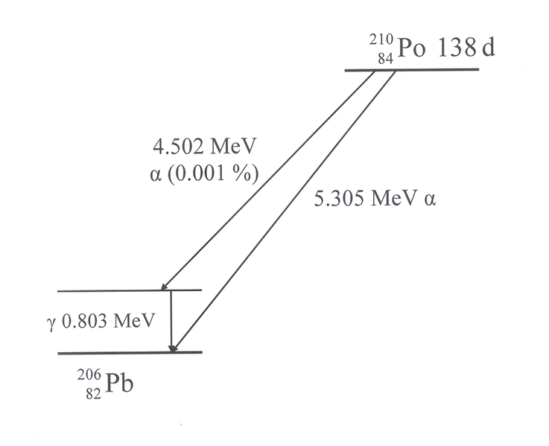
Alpha emitter
A single gram of ²¹⁰Po generates energy at the rate of 150 watts.
Since nearly all alpha radiation can be easily stopped by ordinary containers and upon hitting its surface releases it energy.
²¹⁰Po has been used as a lightweight heat source for artificial satellites.
https://commons.wikimedia.org/wiki/File:Polonium_210.png

Slide 27
²¹⁰Po used as a poison
Weight for weight Po-210 is a million times more toxic than hydrogen cyanide.
The maximum allowable body burden for ingested polonium is only seven picograms which gives a maximum allowable body burden for ingested polonium of 1100 Bq.
The amount of material required to produce a lethal dose would only be 0.12 micrograms.
The alpha radiation has enough energy to tear apart the DNA killing or causing them to mutate into tumor-producing forms although the radiation penetrate about 60 μm through biological tissue- equivalent to the wall cell thickness.
Notes:
ไซยาไนด์ (อังกฤษ: cyanide) เป็นสารพิษชนิดหนึ่ง มีทั้งในรูปของแข็งและก๊าซ
ไซยาไนด์ (Cyanide) ที่คุ้นๆ กันดีมีอยู่ 2 รูปแบบ คืออย่างเป็นก๊าซ นั่นคือ ไฮโดรเจนไซยาไนด์ (Hydrogen Cyanide) ซึ่งมีสูตรเคมีว่า HCN จะเรียกมันว่าก๊าซไซยาไนด์ (Cyanide gas) ก็ได้ และอย่างที่เป็นเกลือของไซยาไนด์ซึ่งก็มีอยู่มากมายหลายตัว แต่ขอพูดถึงแต่โพแทสเซียมไซยาไนด์ (Potassium Cyanide; สูตรเคมี KCN)
Hydrogen cyanide เกิดจากสารไซยาไนด์ทำปฏิกิริยากับกรดได้เป็นก๊าซที่ชื่อว่า ไฮโดรเจนไซยาไนด์
The alpha particles are incapable of penetrating a few sheets of paper of the epidermis of skin.
Alpha particles can be stopped by clothing and intact skin.
Alpha radiation represents and internal contamination and internal irradiation hazard only if the particles are inhaled, ingested or injected by penetrating wounds.

Slide 28
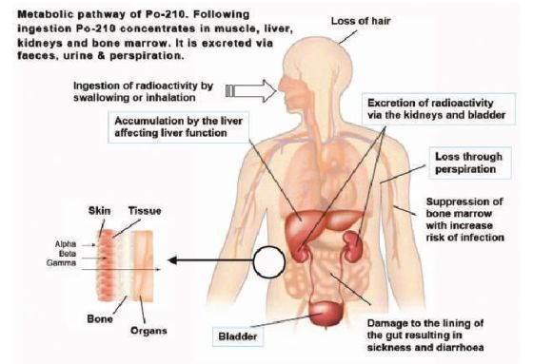
The effect of Polonium poisoning
http://warincontext.org/2012/07/04/the-effects-of-polonium-poisoning/
Notes:
Epithelial lining เนื้อเยื่อบุผิว
Alimentary tract ทางเดินอาหาร

Slide 29
Detection of Po-210
Polonium-210 inside someone’s body is not detectable with standard radiation survey instruments used outside that person’s body.
Testing the individual’s urine or feces for alpha radiation would be the method of detection.
The radioactive substance sometimes called the "Perfect Poison."

Slide 30
Summary
Po-210 : the perfect poison
Polonium is an immensely powerful poison. Its presence in the body is also very hard for doctors to identify unless they are looking specifically for it.
Part of the difficulty in detecting polonium poisoning is that its outward symptoms resemble poisoning with much less powerful substances. Among the earliest symptoms are hair loss, which is also a standard symptom of poisoning by thallium, an element in rat poison.
This ability of polonium to conceal its presence by appearing to be another, simpler, poison enables it to fool investigators into looking for other culprits than the real assassin.

Slide 31
